Slide 1
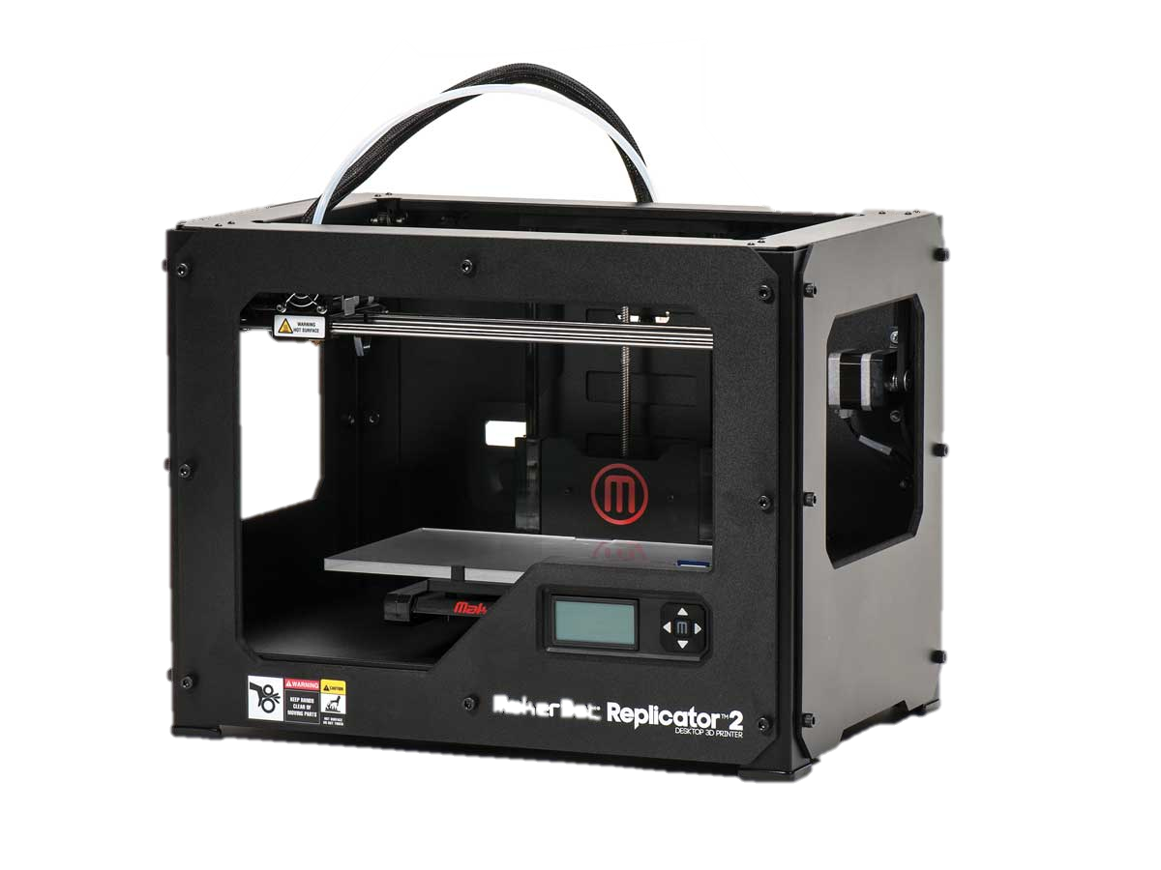

3D Printing
&
“Basic printer use, safety, and how not to fucking destroy our nice things holy fucking shit you guys!” ~Colin
By: Spencer K

Slide 2
This will cover
3D Printing technologies
Modeling for 3D printing
Exporting models
Slicing your model
Setting up the 3D Printer
Printing
Monitoring
Finishing your print

Slide 3
3D Printing technologies
How to export your model to a standard format

Slide 4
Three main types
Stereo lithography
SLA or DLP
Binder Jetting
Drop-on-powder
Fused Deposition Modeling
FDM

Slide 5
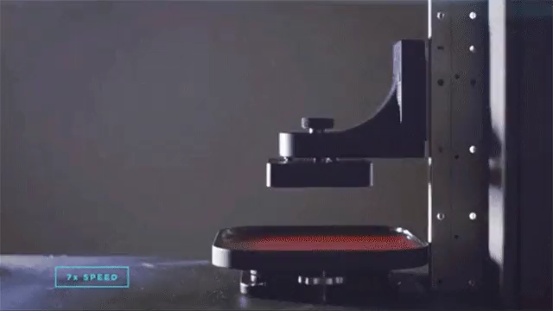
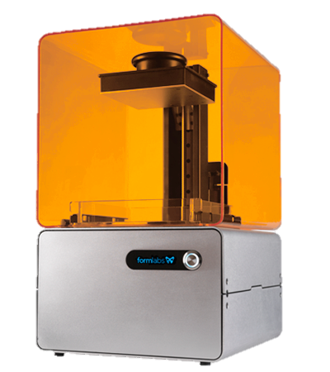
Stereo lithography
Light Reactive Fluid
Fluid tray
Bakes model to harden
Pros
Extremely detailed prints
Overhangs
Cons
Messy
Expensive
Slow

Slide 6
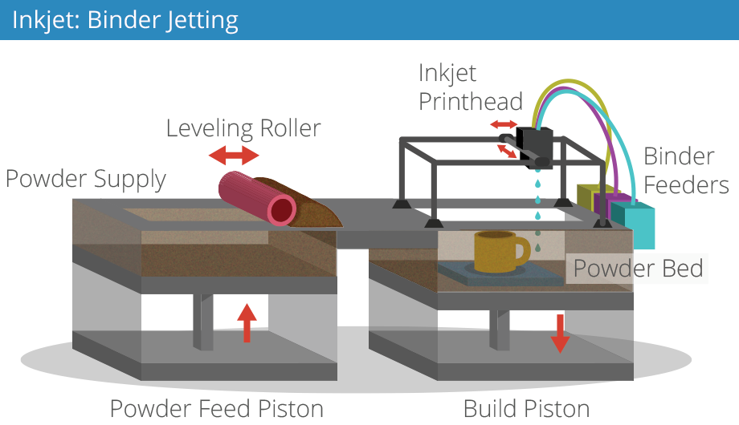
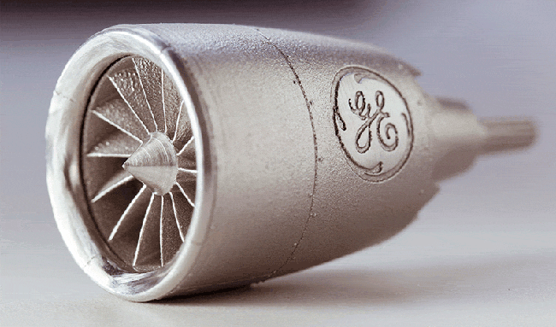
Binder Jetting
Powdered substrate
Liquid binding agent
Pros
Infinite colors
High detail
Exotic materials
Cons
Brittle until baked/cured
Large machines

Slide 7
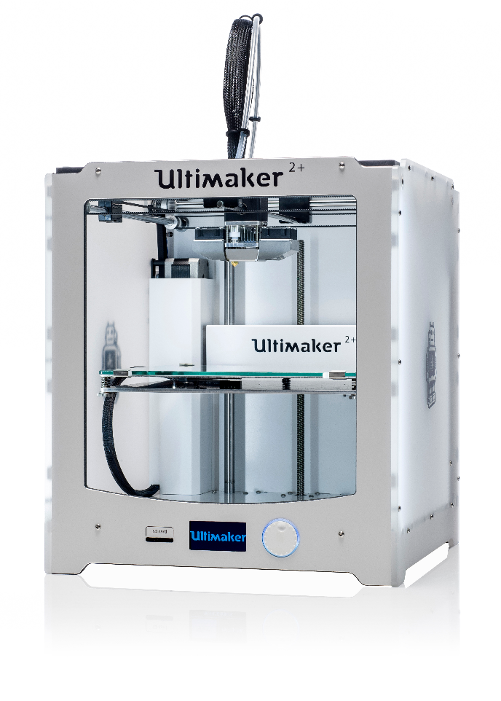
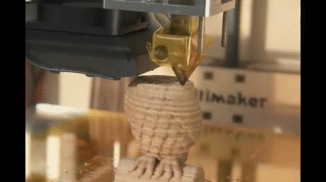
Fused Deposition Modeling
PLA or ABS Plastic
Heated extrusion head
Pros
Quick
Relatively inexpensive
Cons
Model design limitations
Sensitive to environment
Notes:
Like a robotic hot glue gun

Slide 8
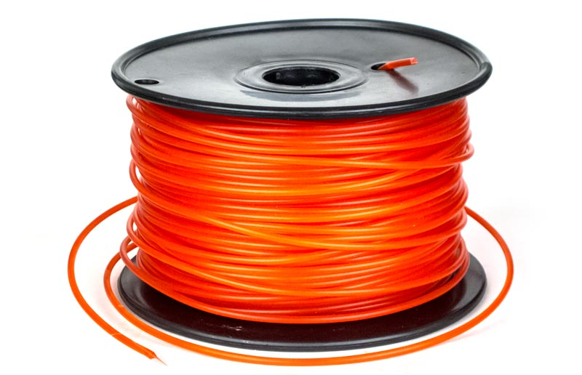
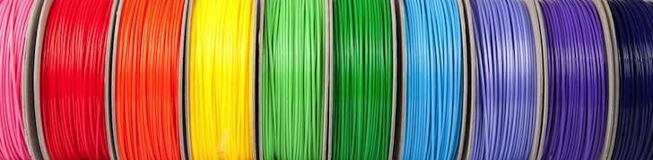
PLA
Not really food safe
Biodegradable
Don’t breathe this
Strong and rigid
Also hates the word moist
Notes:
Keep the filament away from moisture.
Ask a 3da to show you how to change the filament

Slide 9
Modeling for 3D printing
Tips to help you design a more robust part

Slide 10
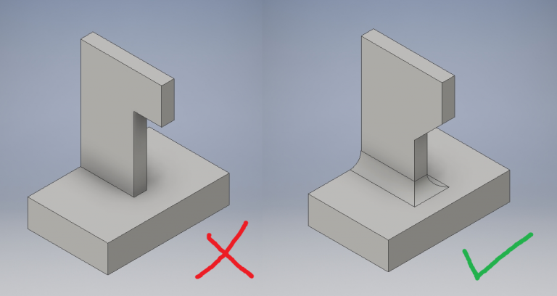
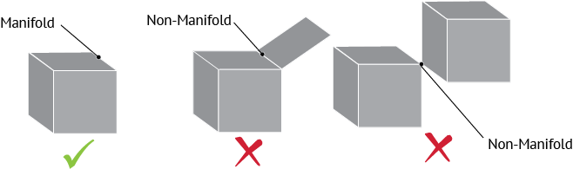
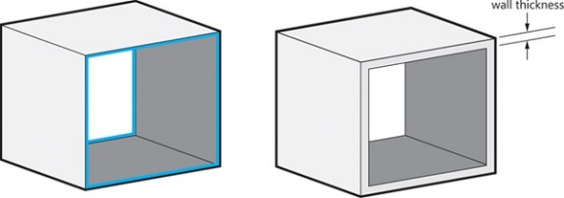
Things to avoid
Hard Edges
90º Overhangs
Non-Manifold geometry
Single point connections
Thin walls
Open solids

Slide 11
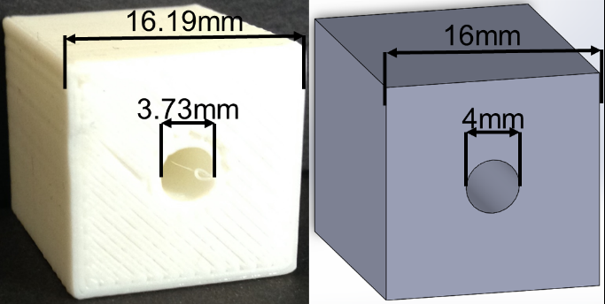
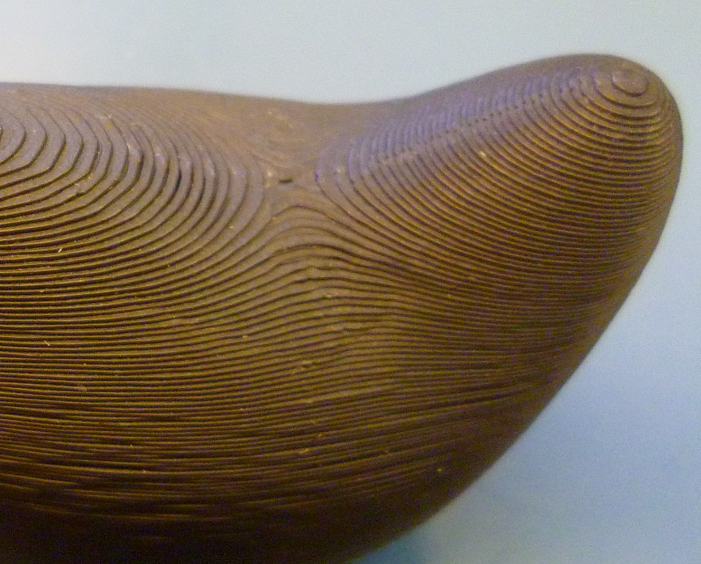
Design considerations
Holes will print slightly smaller
Outer diameters will print slightly larger
Organic surfaces will have layers

Slide 12
Exporting your model
How to export your model to a standard format

Slide 13
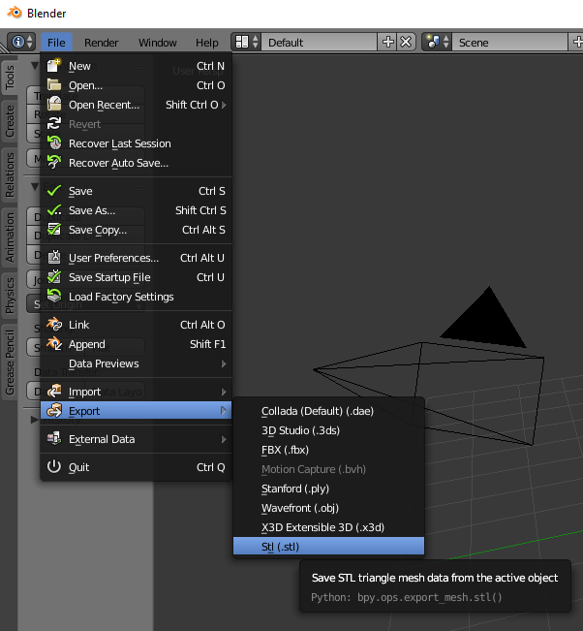
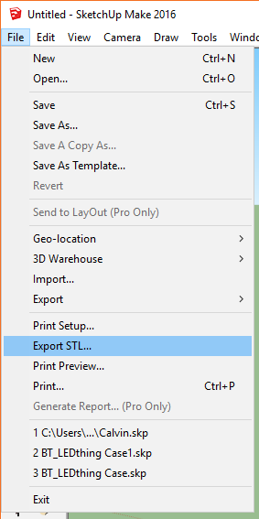
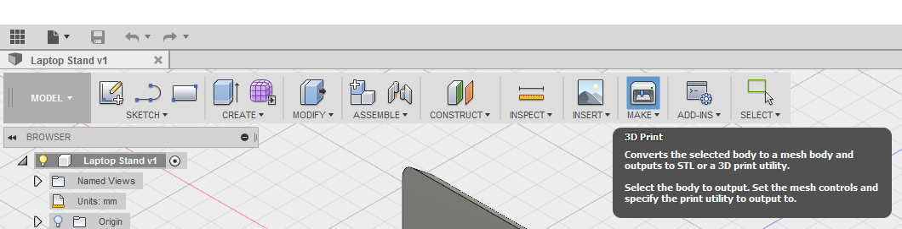
Export as an .stl
Make sure you have the correct units.
Export one part at a time

Slide 14
Slicing your model
Generate the Gcode

Slide 15
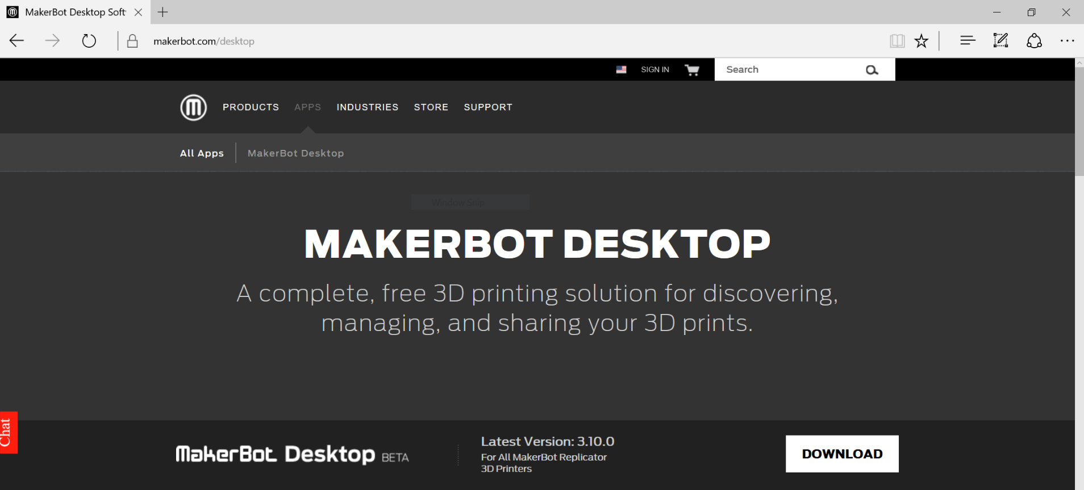
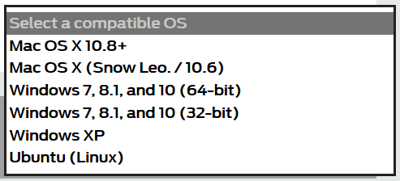
Download the MakerBot Desktop software
Makerbot.com/desktop
RIP Linux users.

Slide 16
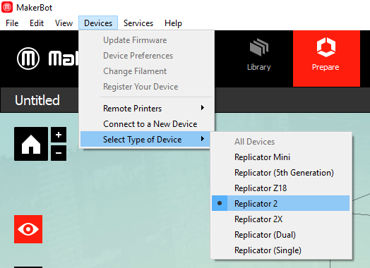
Set the device model
Select the Replicator 2 from the devices menu
You will only have to do this once.

Slide 17
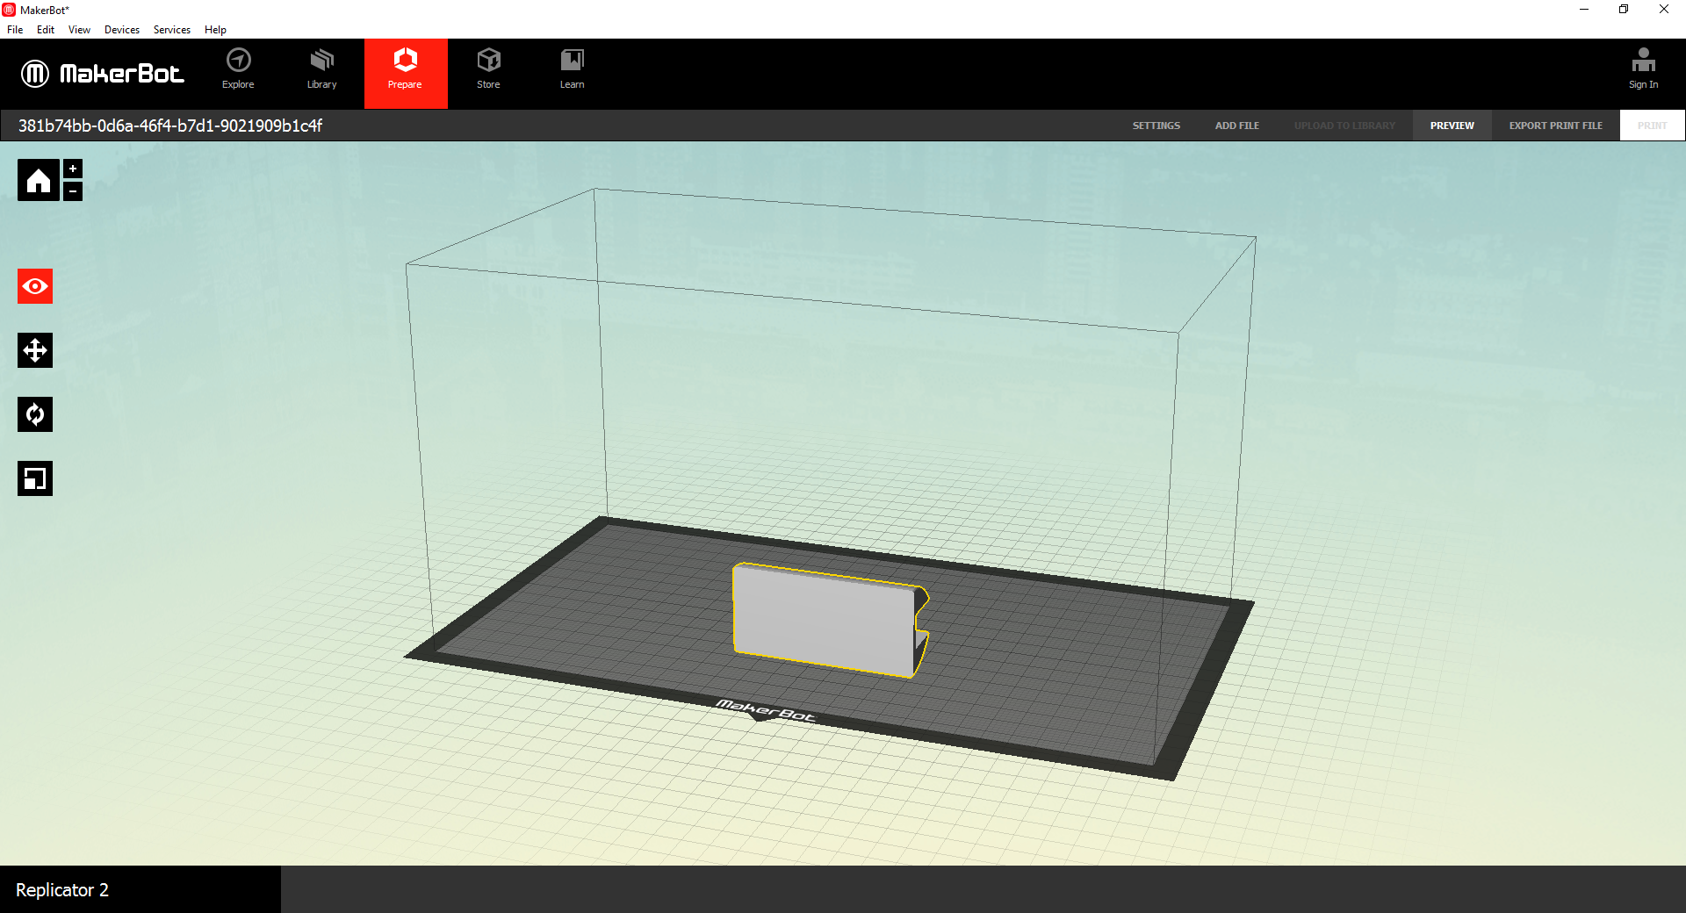
Settings
Export
Look
Move
Rotate
Scale

Slide 18
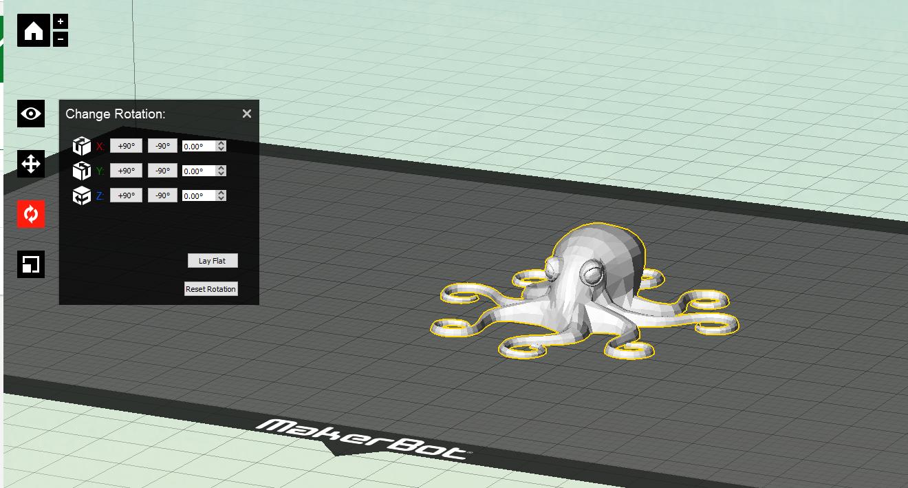
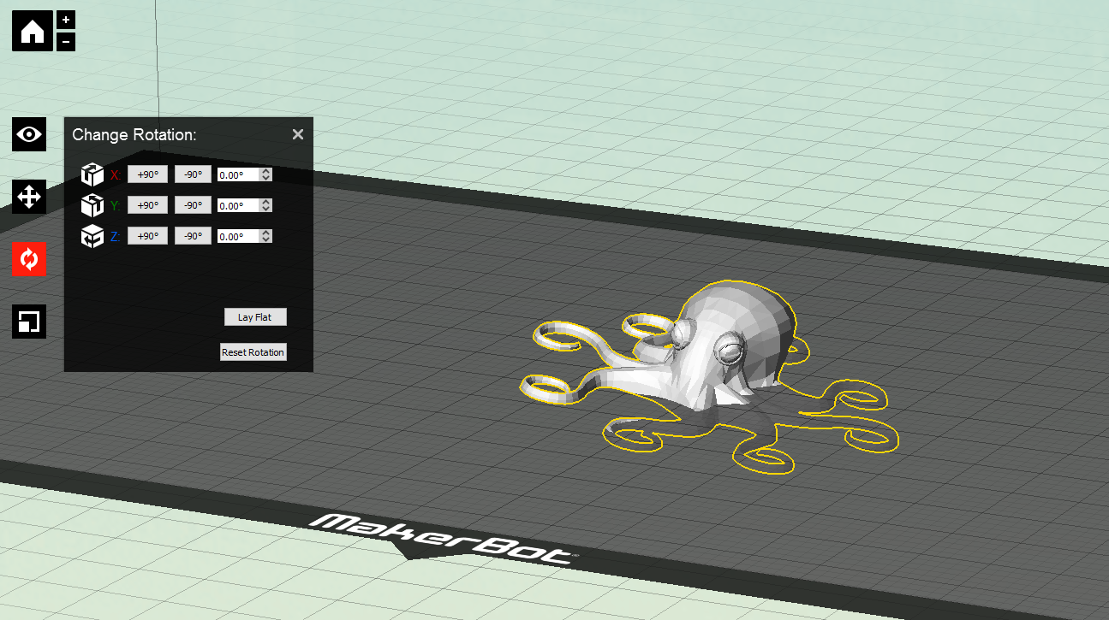
Lay flat

Slide 19
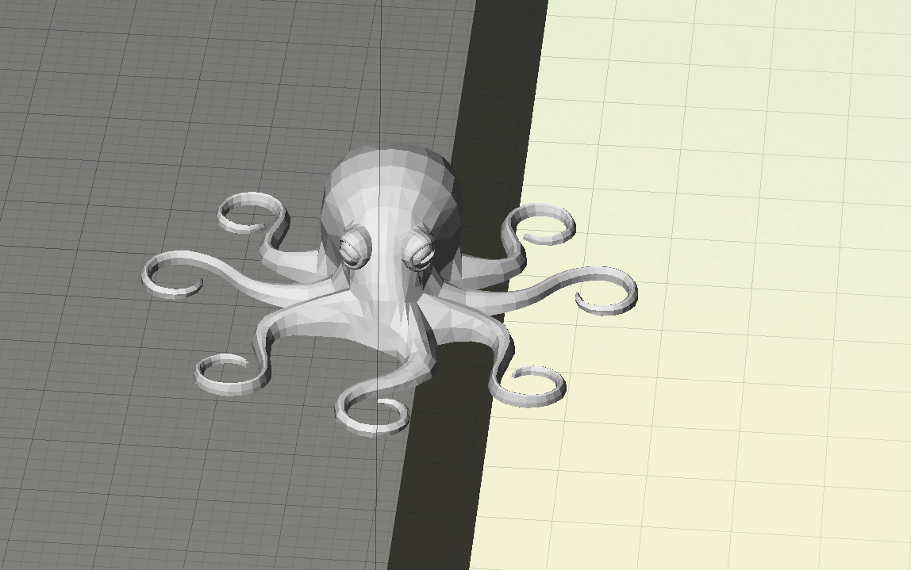
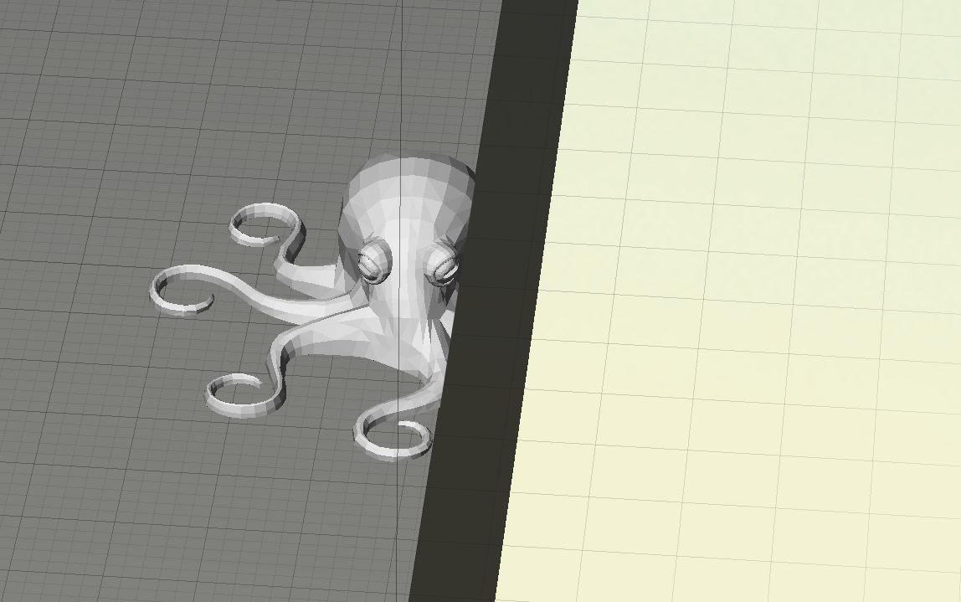
Keep it inside the build area

Slide 20
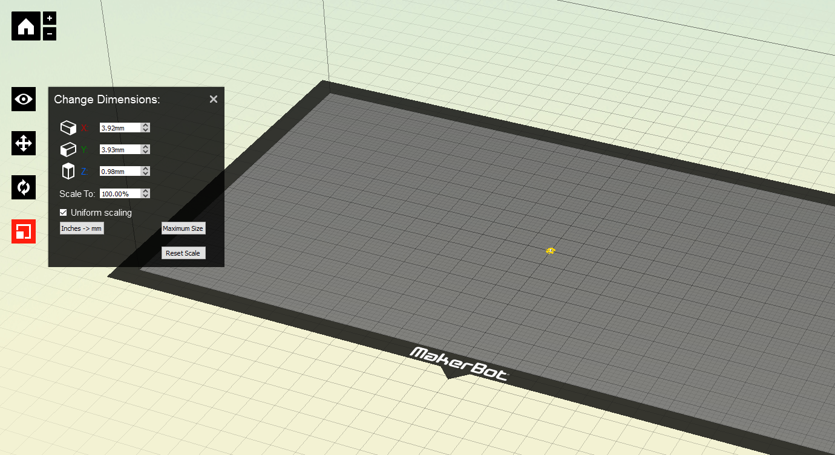
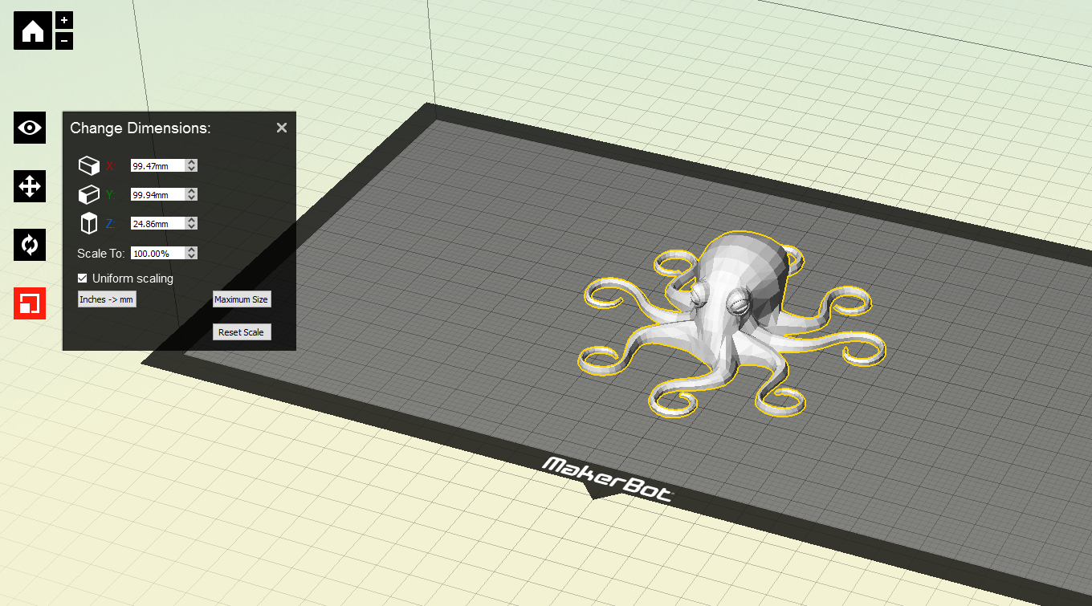
Convert from inches to millimeters
If your print shows up tiny in the build area.

Slide 21
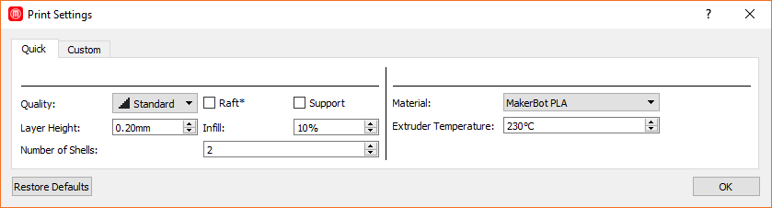
Settings
Three things you will change:
Raft
Support
Shells
Infill

Slide 22
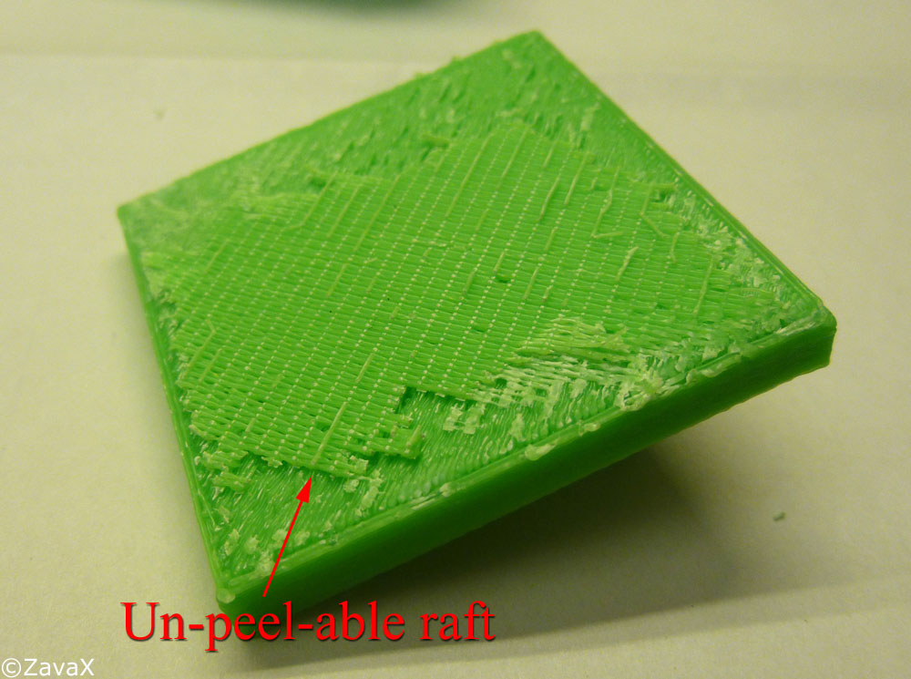
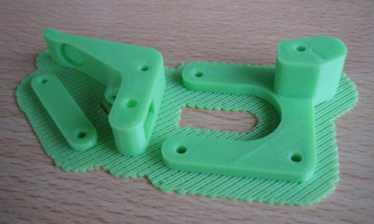
Rafts
Prints a thick layer first to overcome print bed roughness
Can hurt more than it helps
Your mileage may vary

Slide 23
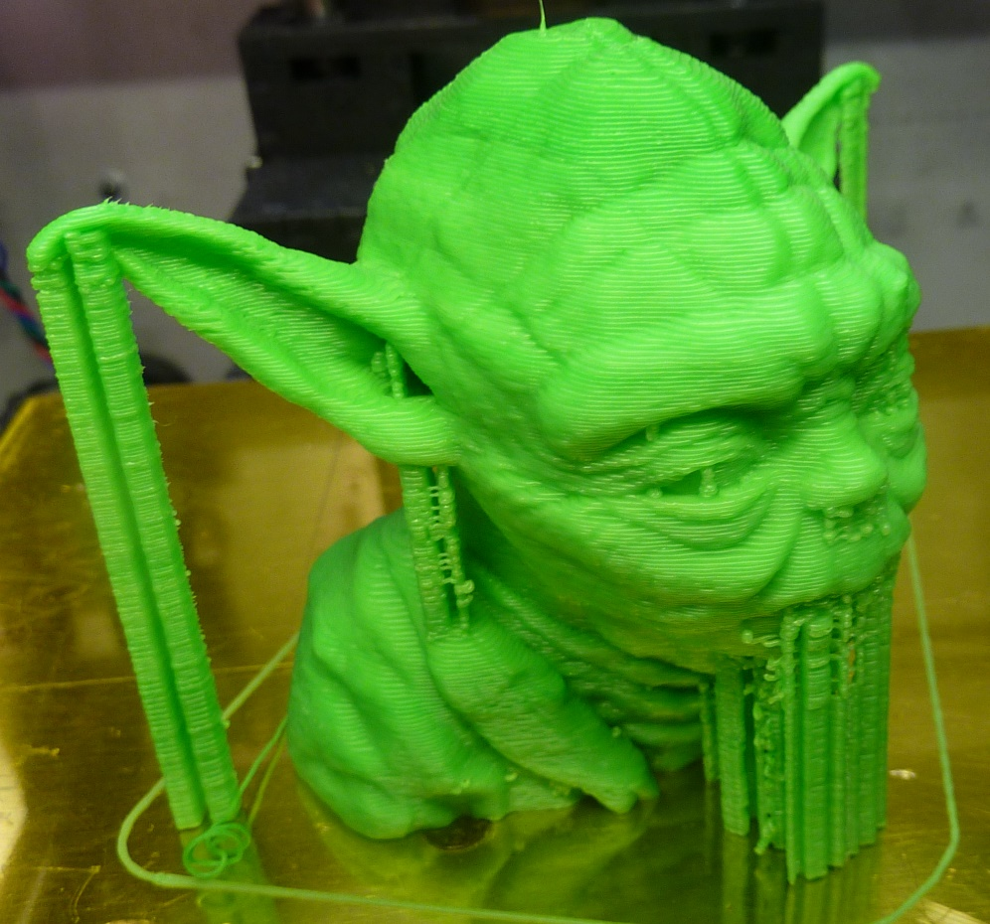
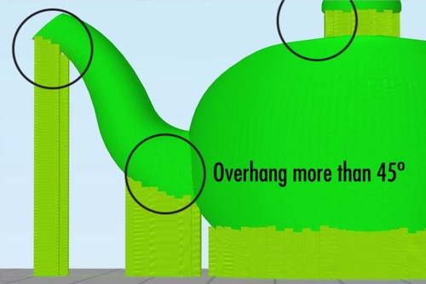
Support
Provides a surface for new layers to print onto
Without it your prints may sag

Slide 24
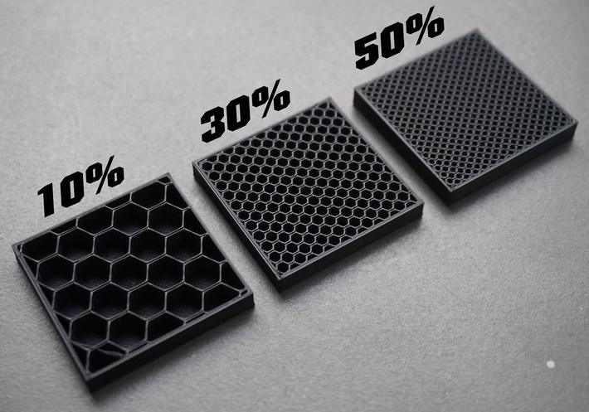
Infill
How solid the print is
10-20% is usually perfectly strong enough

Slide 25
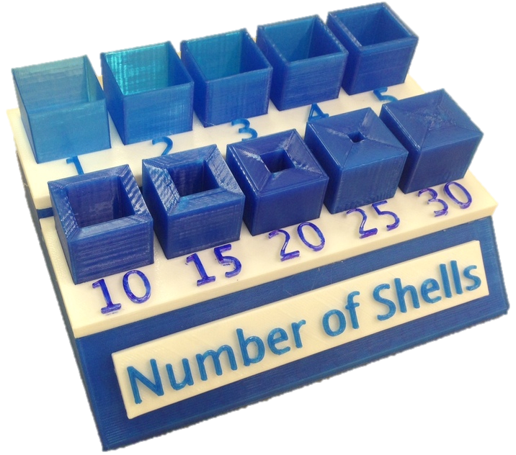
Number of Shells
Outer layers of the print
Unrelated to infill
More is stronger
2 is usually fine

Slide 26
Setting up the 3D printer
Preparing the print bed

Slide 27
Level the build plate
THIS IS THE MOST IMPORTANT PART!

Slide 28
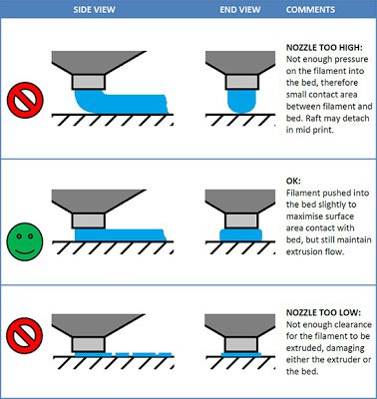
Why leveling is important
Not enough pressure
Filament doesn’t stick
Print lifts off and fails
Good contact
Filament is lightly spread out
Ideal
Too much pressure
Filament can’t flow
No good

Slide 29
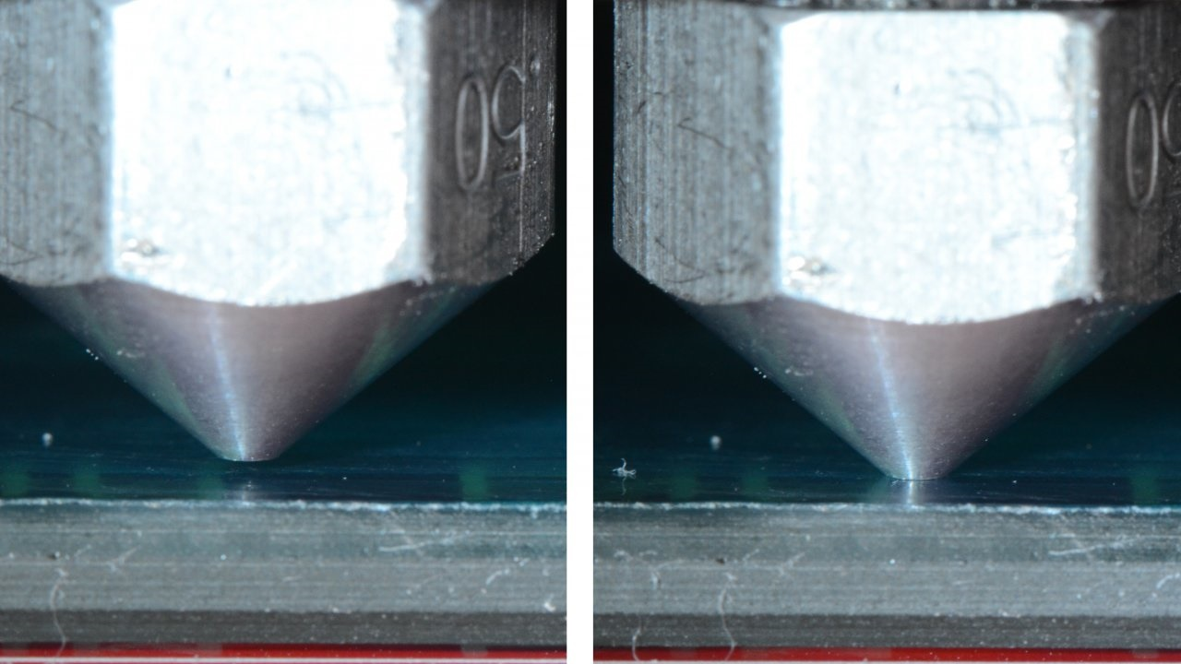
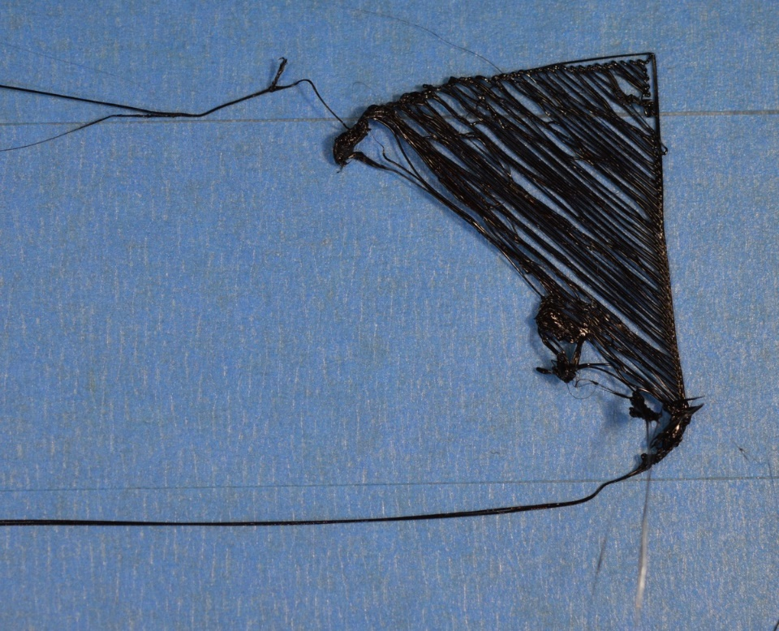
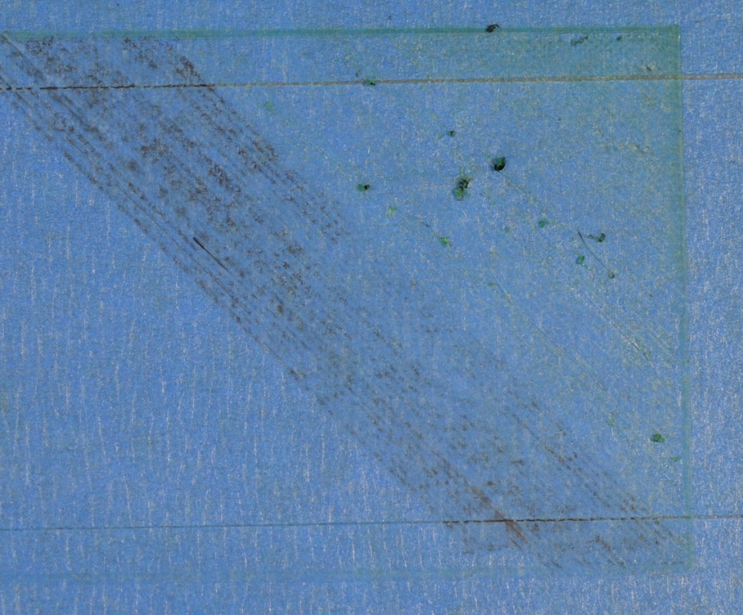
Too far
Too close

Slide 30
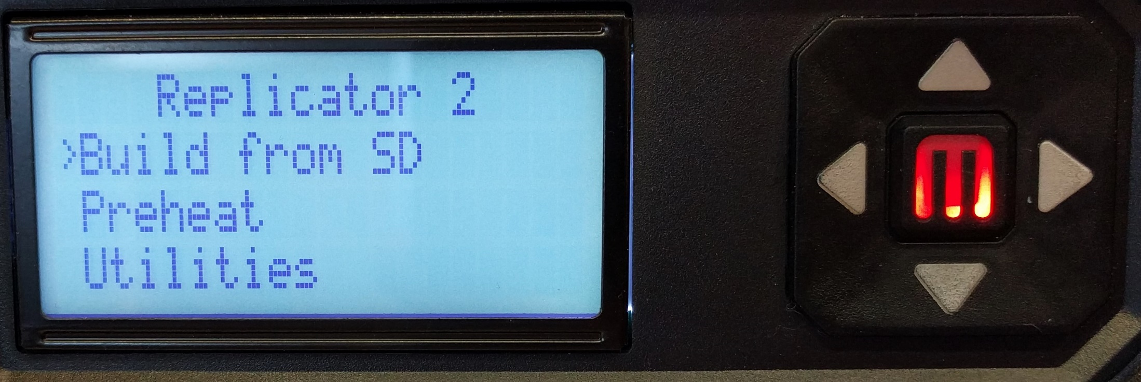
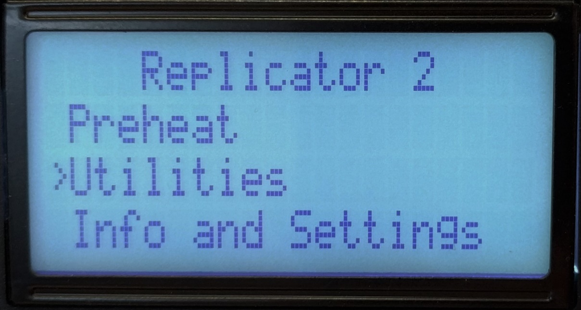
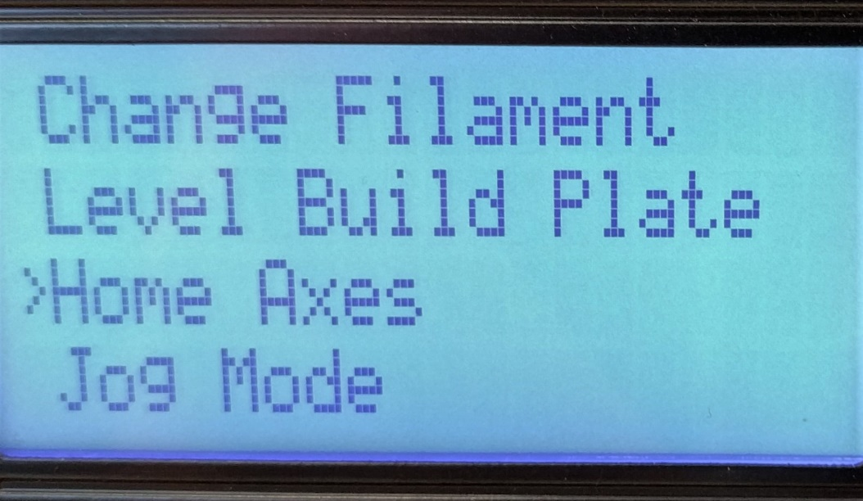
Leveling the build plate
Home Axes
Notes:
Go down to utilities
Enter, go to Home axes

Slide 31
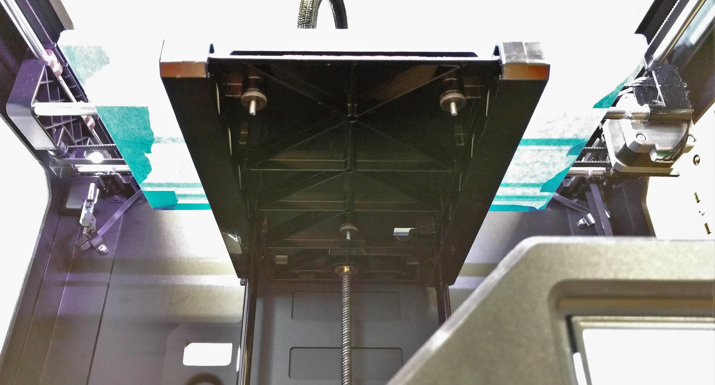
Leveling the build plate
Locate screws

Slide 32
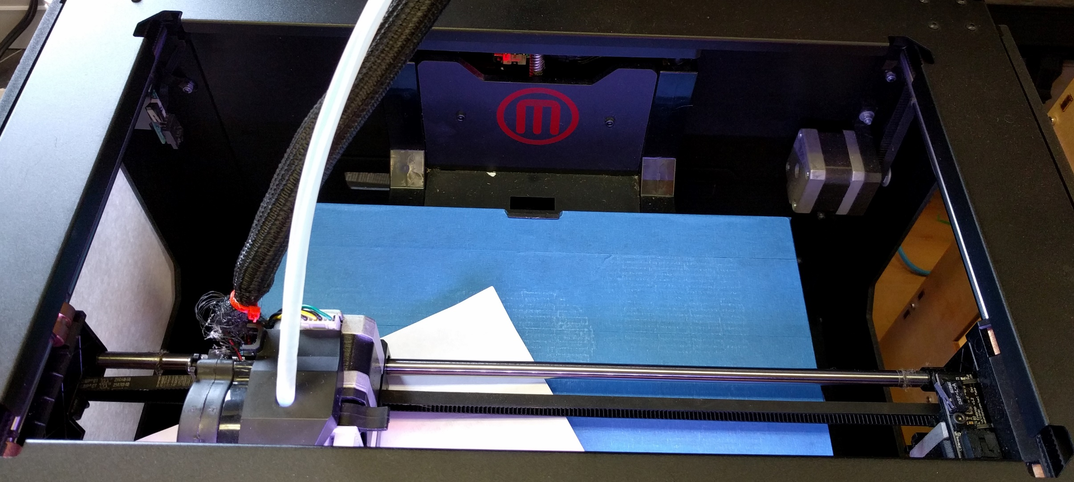
Leveling the build plate
Level front LEFT

Slide 33
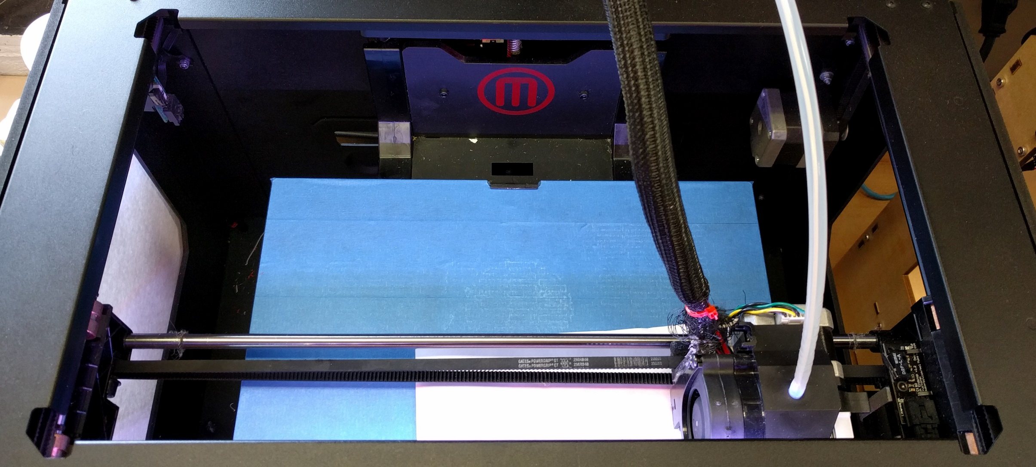
Leveling the build plate
Level front RIGHT

Slide 34
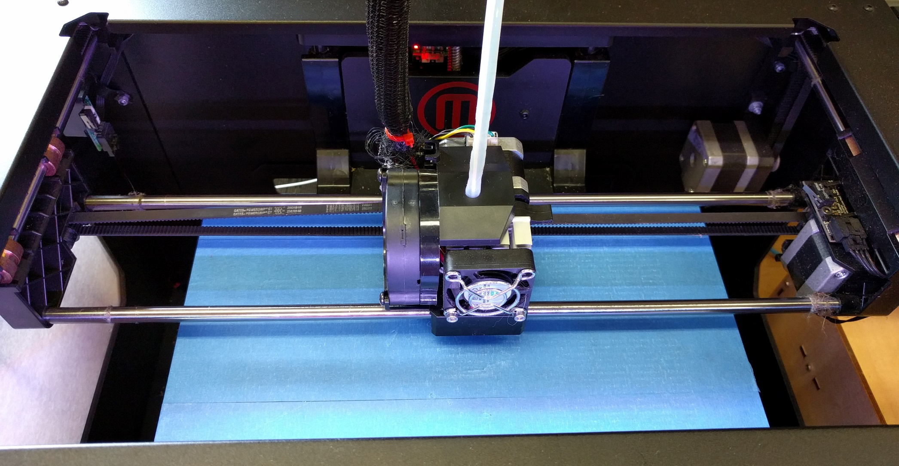
Leveling the build plate
Level the BACK

Slide 35
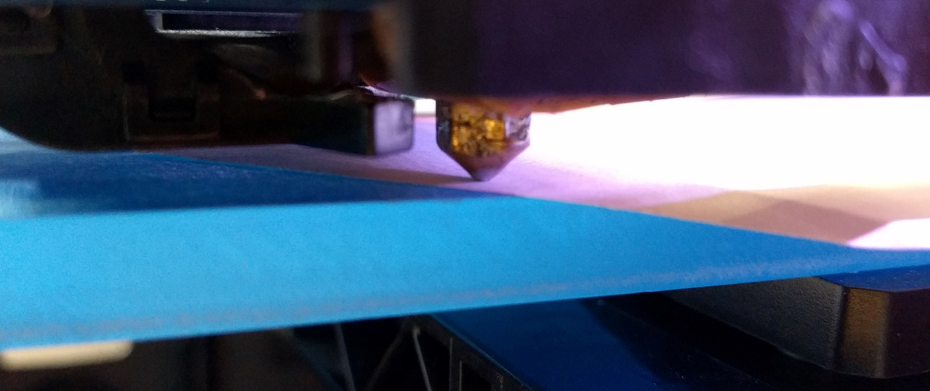
Leveling the build plate
Paper should touch but freely move back and fourth.

Slide 36
Why leveling is important
Not enough pressure
Filament doesn’t stick
Print lifts off and fails
Good contact
Filament is lightly spread out
Ideal
SHEET OF PAPER
Too much pressure
Filament can’t flow
No good

Slide 37
Printing
What you actually came here to do.

Slide 38
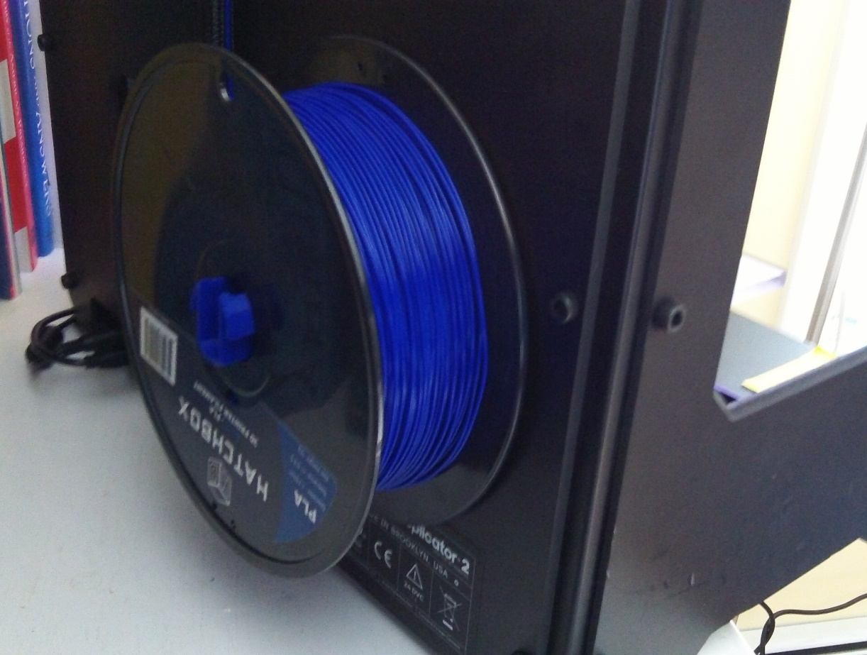
Check the filament
Make sure you won’t run out
No automated way of knowing how much is left

Slide 39
Print your model

Slide 40
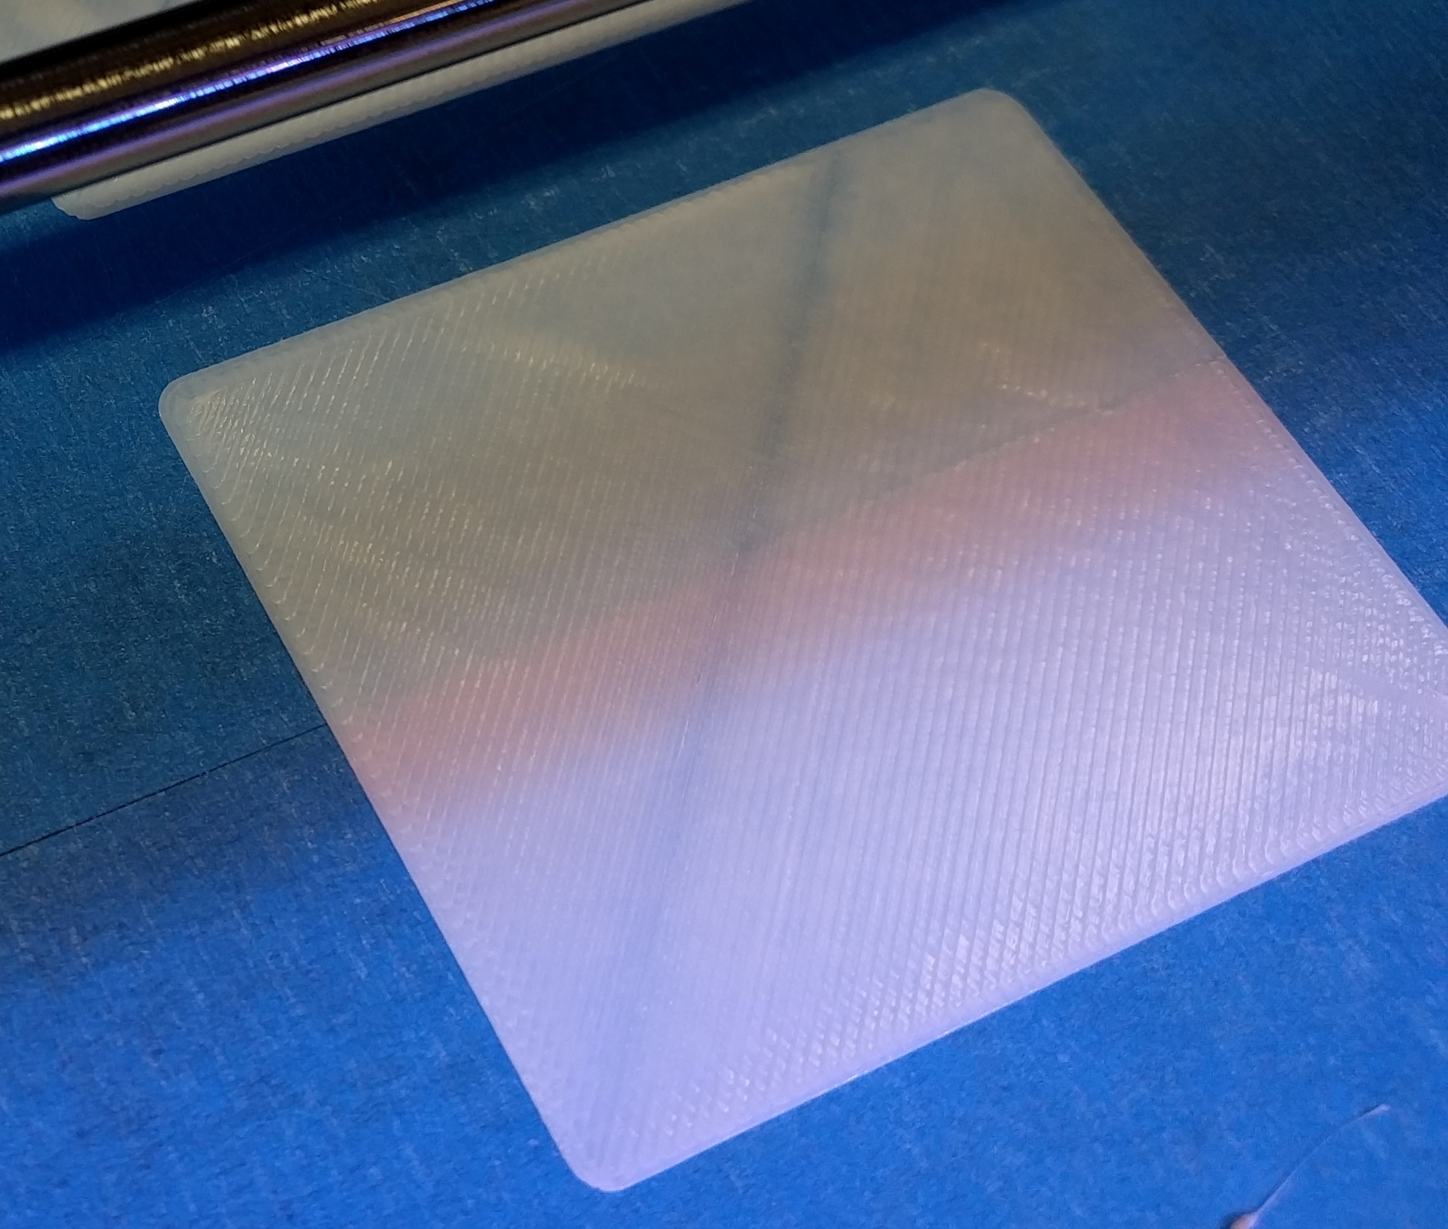
Watch the first layer
If it isn’t even and clean, you are gonna’ have a bad time.

Slide 41

DON’T TOUCH IT
Notes:
You’ll just fuck it up (the print, your fingers, or the printer)

Slide 42
Monitoring
Checking in on your print

Slide 43
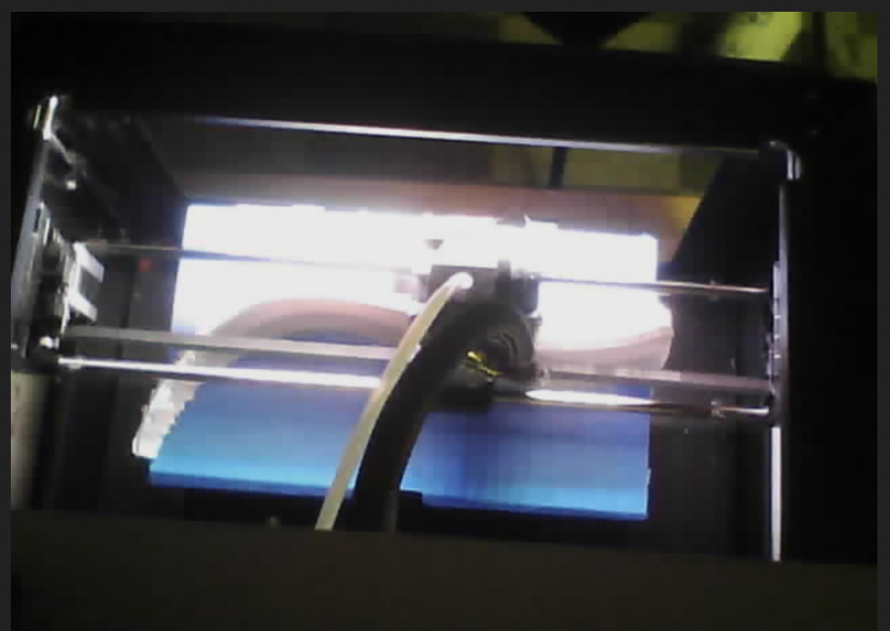
Keep an eye on it
Stay and watch the first layer complete
Watch the stream online:
thundercam.csh.rit.edu/video.cgi

Slide 44
Finishing your print
Removing and cleaning your 3D print

Slide 45
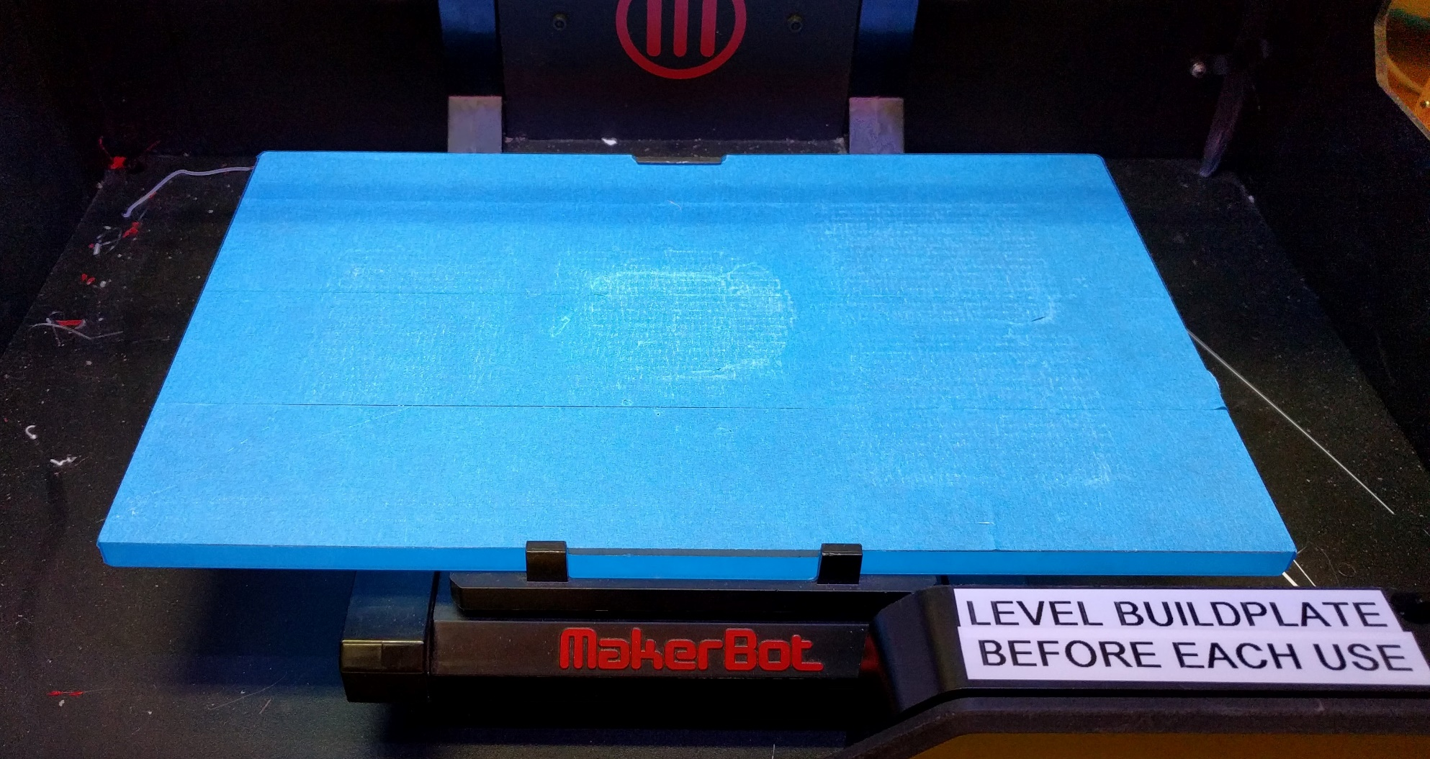
Remove the build build plate
Push back, then lift the front.
1
2
2
lift
Push back
lift

Slide 46

Remove print from build plate
Start at the corner and slowly pry like you’d turn a key.

Slide 47

Cleaning support and fluff
Manicure tools work very well.

Slide 48
Recap
If you’ve been asleep for the entire presentation, wake up and remember this part.

Slide 49
Keep it inside the build area

Slide 50
Level
The
Build plate

Slide 51
DON’T TOUCH IT
While it’s moving, hot, or otherwise doing its thing.
Notes:
You’ll just fuck it up (the print, your fingers, or the printer)

Slide 52
3D Admins
Me:
goblin@csh.rit.edu
spencerk@csh.rit.edu
Fish 3049
The Research Room
Brick City @ lunchtime
Other 3DAs:
3da@csh.rit.edu
Colin O. @faokryn
Drew G. @dag10
Marc B. @mbillow
Max B. @maxime
Trevor S. @sherrardtr

